Slide 1
Procurement & Contract Terms & Conditions for Utilities
Jean Block, Chief Legal Officer
Little Rock Wastewater

Slide 2
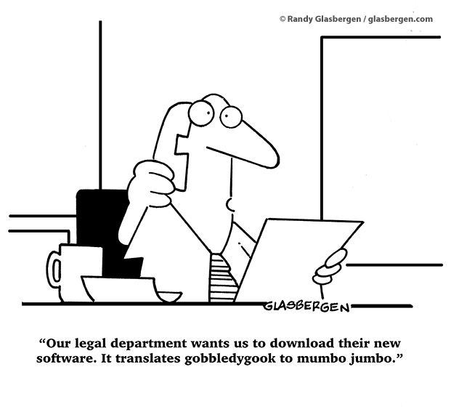
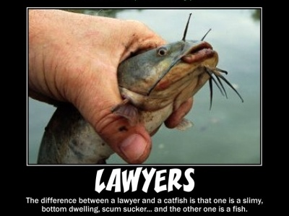
A LITTLE HUMOR BEFORE THIS DRY TOPIC

Slide 3
Why this topic?
How we got here
Procurement + Contracts = How utilities get things done
Two categories of utility procurements - my presentation will cover both

Slide 4
Two Categories of Utility Procurements
GENERAL PROCUREMENTS
ENGINEERING SERVICES
Lawn services
Pipes
Vehicles
Professional Services
  Banking service
  Janitorial services
  Legal services
Feasibility Study Phase
Preliminary Engineering Phase
Design Phase (Full Engineering Design)
Bid Phase (bidding for the actual Contractor to Construct the project)
Construction Phase

Slide 5
Procurement (Bid) Documents
REQUEST FOR QUALIFICATIONS
Professional services
Section based upon the bidder's qualifications. Only after the most qualified respondent is identified does cost become a factor.
REQUEST FOR PROPOSALS
Services with defined need
Award is made to the responsible bidder whose proposal is determined to be the most advantageous, taking into consideration price, evaluation factors set forth in the solicitation, and vendor qualifications. - Price in not a primary evaluation factor.
INVITATIONS TO BID
  Items where low price is the key factor
  Awarded to the responsive and responsible bidder who has submitted the lowest bid that meets the requirements and criteria set forth in the solicitation.

Slide 6
Key Terms & Conditions in Bid Documents
Cone of Silence
Indemnification
FOIA / Proprietary Information
Conflict of Interest Disclosure
Publicity
Right to award or not award a contract
Award to multiple vendors

Slide 7
Key Terms & Conditions in Bid Documents
Cone of Silence
Communication pertaining to this bid shall be directed to the LRW buyer listed on page one of this solicitation. LRW has imposed an absolute prohibition against any communication or contact with any other LRW personnel, consultant, or Little Rock Water Reclamation Commission member regarding this bid process.
The prohibition begins with the publication of this solicitation document, remains in place through the LRW solicitation and award process, and ends only after LRW has executed a contract with the successful vendor.
The prohibition is suspended only when the LRW Buyer initiates or consents to a meeting or communications for the purpose of clarifying a solicitation or another solicitation-related action.
A violation of this policy may result in the disqualification of an offending vendor’s response.

Slide 8
Key Terms & Conditions in Bid Documents
Indemnification
Vendor shall indemnify and save harmless LRW and its employees from all suits, actions, legal proceedings, claims, demands, damages, costs…….of any nature whatsoever incurred by any of them including attorney's fees arising out of a willful or negligent act, or omission.
However, Vendor shall not be liable for any suits, actions, legal proceedings, claims, demands, damages, costs…..arising out of the award of any resulting contract or a willful or negligent act, or omission of LRW.

Slide 9
Key Terms & Conditions in Bid Documents
Freedom Of Information Act
  Response documents shall be subject to the Arkansas Freedom of Information Act (FOIA).
  Vendor is responsible for identifying proprietary information. Provide redacted copy of bid documents.
  Utility decides if redacted information is subject to FOIA. If utility’s lawyer does not believe redacted information meets standard to withhold from FOIA request, inform the Vendor before releasing the documents.

Slide 10
Key Terms & Conditions in Bid Documents
Conflict of Interest Disclosure
  Vendor must disclose all known possible conflicts of interest, which exist at the time of vendor's bid submission. Conflicts of interest include, but are not limited to the following:
    Relationships between vendor's employees, officers, and the employees of LRW.
    Relationships between vendor's employees, officers, and the LRWRC.
  Vendor's failure to disclose such a relationship may result in one of the following: LRW's rejection of vendor's bid response or LRW's cancellation of any resultant contract.

Slide 11
Key Terms & Conditions in Bid Documents
Publicity
Vendor shall not issue a news release or article pertaining to this solicitation or any portion of the project, in any medium, at any time during the pendency of the solicitation or fulfillment of the terms of this contract without LRW’s prior written approval. Vendor’s failure to comply with this requirement may be cause for LRW’s rejection of Vendor’s response or LRW’s cancellation of this contract.

Slide 12
Key Terms & Conditions in Bid Documents
Right to Award Contract/ Multiple vendors
Right to Award/Not Award Contract
“LRW shall have the right to award or not award a contract, if it is in the best interest of LRW to do so. “
Award to Multiple Vendors
LRW anticipates awarding a term contract to the three (3) highest ranked firms or attorneys.
LRW makes no representation or warranty of any nature that any firm selected pursuant to this RFQ will participate in any minimum or maximum number of transactions.

Slide 13
You’ve done the procurement
Next comes the contract!
Utility’s contract – You’re in control!
Vendor’s contract - Pay attention (but you’re still in control)!
Contract amendments – Pay attention!
Purchase order – You’re in control!
TEMPLATES TEMPLATES TEMPLATES

Slide 14
Vendor Contracts - What to watch for!
Indemnification / Hold harmless provisions
Commercial liability or general liability insurance coverage provisions
Venue & Governing law provisions
Automatic renewal provisions

Slide 15

Vendor Contracts - What to watch for!
Indemnification/Hold Harmless Provisions
“OSHA Compliance: Customer shall indemnify Company from and against any and all claims, demands and/or damages arising in whole or in part from the enforcement of the OSHA unless said claims, demands or damages are a direct result of causes within the exclusive control of Company.”
“Licensee shall hold Vendor, it’s developers, and affiliates harmless from any loss or claim resulting directly from Licensee’s use of possession of the XX software.”

Slide 16
Vendor Contracts - What to watch for!
!Utilities Have Statutory Immunity!
Arkansas Code Annotated § 21-9-301. Tort liability--Immunity declared
(a) It is declared to be the public policy of the State of Arkansas that all counties, municipal corporations, school districts, public charter schools, special improvement districts, and all other political subdivisions of the state and any of their boards, commissions, agencies, authorities, or other governing bodies shall be immune from liability and from suit for damages except to the extent that they may be covered by liability insurance.
My response: “Pursuant to Ark. Code Ann. 21-9-301, LRW is immune from liability and suit for damages. Accordingly, it is our standard policy to not agree to Indemnification clauses.”

Slide 17
Vendor Contracts - What to watch for!
Insurance Coverage Provisions
“Licensee will maintain and pay all premium costs for the following insurance coverages: “Commercial General Liability Insurance / Umbrella Liability Insurance….”
“You expressly agree to name XX as additional insureds in your liability and any excess umbrella liability insurance policies.”

Slide 18
Vendor Contracts - What to watch for!
!Utilities Have Statutory Immunity!
Arkansas Code Annotated § 21-9-301. Tort liability--Immunity declared
(a) It is declared to be the public policy of the State of Arkansas that all counties, municipal corporations, school districts, public charter schools, special improvement districts, and all other political subdivisions of the state and any of their boards, commissions, agencies, authorities, or other governing bodies shall be immune from liability and from suit for damages except to the extent that they may be covered by liability insurance.
(b) No tort action shall lie against any such political subdivision because of the acts of its agents and employees.
My response: “LRW does not carry a commercial general liability insurance policy because it has immunity from tort liability pursuant to Ark. Code Ann. § 21-9-301.”

Slide 19
Vendor Contracts - What to watch for! Automatic Renewal Provisions
“This Agreement will self-renew on an annual basis after the initial term unless terminated by Utility or Vendor.”
“To ensure continuous service, this agreement will be automatically renewed for successive 60 month periods, unless either party timely serves written notice upon the other party of its intention to cancel renewal at least 90 days but not more than 120 days before the end of the initial 60 month period…” Notice shall be sent by certified mail, return receipt requested.”

Slide 20
Vendor Contracts - What to watch for! Venue & Governing Law Provisions
“This Agreement will be governed by the laws of the State of Florida, U.S.A. Each party submits to the jurisdiction of the federal and state courts in Maricopa County, Florida and agrees that any action brought in connection wit this Agreement shall be exclusively brought in such courts.”
“This Agreement will be governed by and construed in accordance with the laws of the State of Ohio, without regard to its choice of laws principles.”

Slide 21
Procurement & Contract Tips
  Pay attention to spending threshold requirements. Use proper purchasing mechanisms based on the amount. For example, LRW’s:
    .01 - $5,000 – No purchase requirement
$5,000 - $19,999.99 – Three quotes must be obtained. See LRW Procurement Code. [City of LR internal policy: minimum requirement for 3 quote bids is $2500]. Two exceptions:
  $20,000+ - Advertise for bids. See A.C.A. 14-235-207 (a)(4)(A) – Powers of Sewer Committee. *See exception below.
  Exceptions – (1) purchase in any amount from vendor on state Cooperative Agreement list. See LRW Resolution 2014-01. Cooperative Agreement list only includes vendors who offer goods, not professional services (architects, etc.) (2) Professional Services Contracts over $5,000 must be bid out via RFQ.
$100,000+ - Purchase must be approved by LRW Commission

Slide 22
Procurement & Contract Tips
Consider joining cooperative contracts. A significant time-saver!
Cooperative contracts have already been bid. You’ll still enter into a contract with a vendor which has Terms & Conditions
Your governing laws and/or governing body determines whether you can or cannot use cooperative contracts.
Examples of governmental cooperatives: US Communities, National Joint Powers Alliance (NJPA), National IPA/TCPN, The Interlocal Purchasing System (TIPS), Houston Galveston Area Council (HGAC), etc.

Slide 23
Procurement & Contract Tips
Utility contracts - What to include at a minimum:
Parties entering into contract
Reference bid documents/ specs/exhibits, etc.
Length of contract / start & end date / Any renewal options
Price
Governing law / disputes
Signatures / Date

Slide 24
Procurement & Contract Tips
  Review all contracts!! Don’t be afraid to ask for edits!
  Utilize local resources for procurement and contract assistance.
  Contract signature authority
  Ensure that the procurement action you’re taking is consistent with what you’re authorized to take.
  Contract amendments – reference original contract

Slide 25


YOU SURVIVED!!

Slide 26
ANY QUESTIONS???
Want contract templates?
Think of a question later?
Call or email me
JEAN BLOCK, CHIEF LEGAL OFFICER, LITTLE ROCK WASTEWATER
501.688.1408 / Jean.Block@lrwu.com

